Slide 1

Abstract Data Types (ADTs)

Slide 2
Index
Definition of an ADT
Examples of an ADT
Operations to be defined for an ADT
How to define an ADT using Java
Advantages of defining an ADT in code

Slide 3
Definition of an ADT
An abstract data type is defined as a mathematical model of the data objects that make up a data type as well as the functions that operate on these objects.
It is called “abstract” because it gives an implementation- independent view.

Slide 4
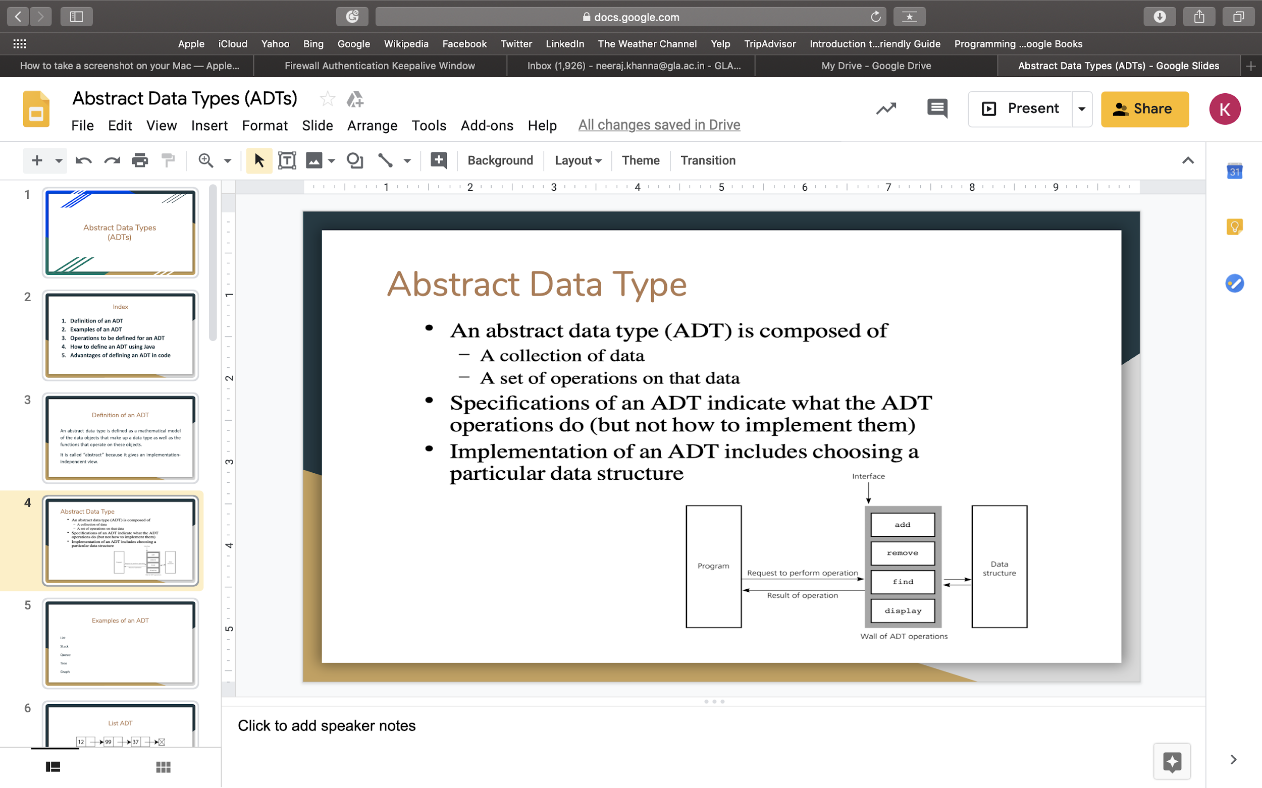

Slide 5
Examples of an ADT
List
Stack
Queue
Tree
Graph

Slide 6

List ADT

Slide 7
Operations of a List ADT
insert(): insert a new node in the list
remove(): remove a node from the list, if it exists
isEmpty(): check if the list is empty, i.e. has no nodes
traverse(): go to all the nodes of a list one by one and process them
search() : check if a particular node exists in the list
sort(): rearrange the nodes of the list based on a particular value

Slide 8
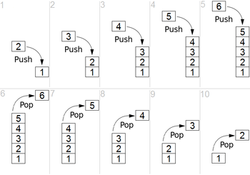
Stack ADT

Slide 9
Operations of a Stack ADT
push(): insert a new node onto the top of the stack
pop(): remove a node from the top of the stack
isEmpty(): check to see if the stack is empty, i.e. has no nodes
traverse(): go to all the nodes of the stack one by one and process them
search(): check to see if a particular node exists inside the stack
sort():re-arrange the nodes of the stack based on a particular value

Slide 10
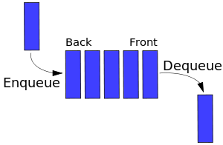
Queue ADT

Slide 11
Operations of a Queue ADT
enqueue(): insert a new node into the queue from the rear
dequeue(): remove a node from the queue from the front
traverse(): go to all the nodes of a queue one by one and process them
isEmpty(): check to see if the queue is empty, i.e. has no nodes
search(): check to see if a particular node exists inside the queue
sort(): re-arrange the nodes of the queue based on a particular value

Slide 12
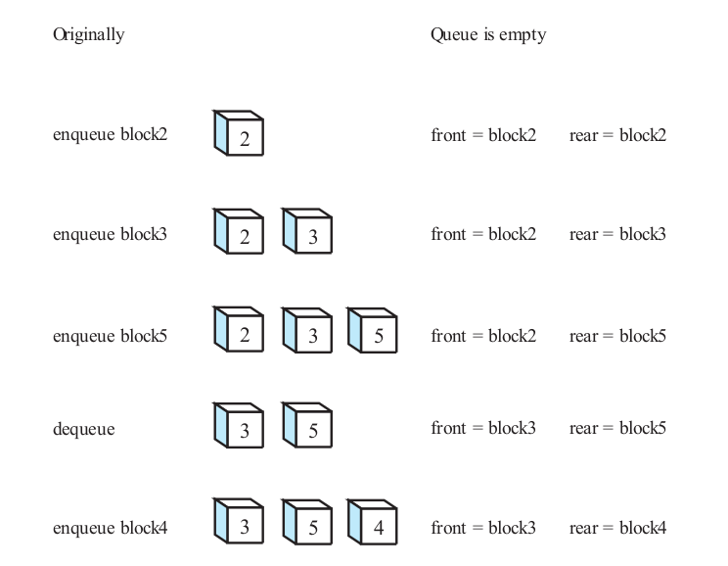

Slide 13
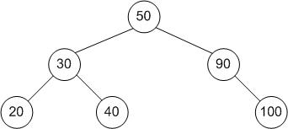
Tree

Slide 14
Operations of Tree ADT
Insert a node: insert a new node into the tree and attach it to left or right of a node
Traverse a tree: go to all the nodes of a tree starting from the root node
Find a node: check to see if a particular node exists inside the tree
Delete a node: remove a node from the tree, if it exists and then re-arrange the tree

Slide 15
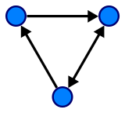
Graph ADT

Slide 16
Operations on a Graph ADT
Traverse a graph: go to all the nodes of a graph one by one, based on a traversing algorithm
Search a graph: check to see if a particular node exists inside the graph
Sort elements in a graph: re-arrange the nodes according to their associated values
Find the smallest path: find the smallest amount of traversing between two nodes

Slide 17
Advantages of an ADT
Encapsulation
Localization of change
Flexibility

Slide 18
Encapsulation
Abstraction provides a promise that any implementation of the ADT has certain properties and abilities.
The user does not need any technical knowledge of how the implementation works to use the ADT.
The implementation may be complex but will be encapsulated in a simple interface when it is actually used.

Slide 19
Localization of change
Code that uses an ADT object will not need to be edited if the implementation of the ADT is changed.
Since any changes to the implementation must still comply with the interface, and since code using an ADT object may only refer to properties and abilities specified in the interface, changes may be made to the implementation without requiring any changes in code where the ADT is used.

Slide 20
Flexibility
Different implementations of the ADT, having all the same properties and abilities, are equivalent and may be used somewhat interchangeably in code that uses the ADT.
For example, different implementations of the ADT may be more efficient in different situations; it is possible to use each in the situation where they are preferable, thus increasing overall efficiency.

